Slide 1
welcome to haines county schools
A Community Conversation About Improving Employment for Students with Disabilities

Slide 2
The Mission of Haines county schools
To provide all students with a data-driven, intellectual and creative learning environment appropriate for success and citizenship in an ever-evolving world.

Slide 3
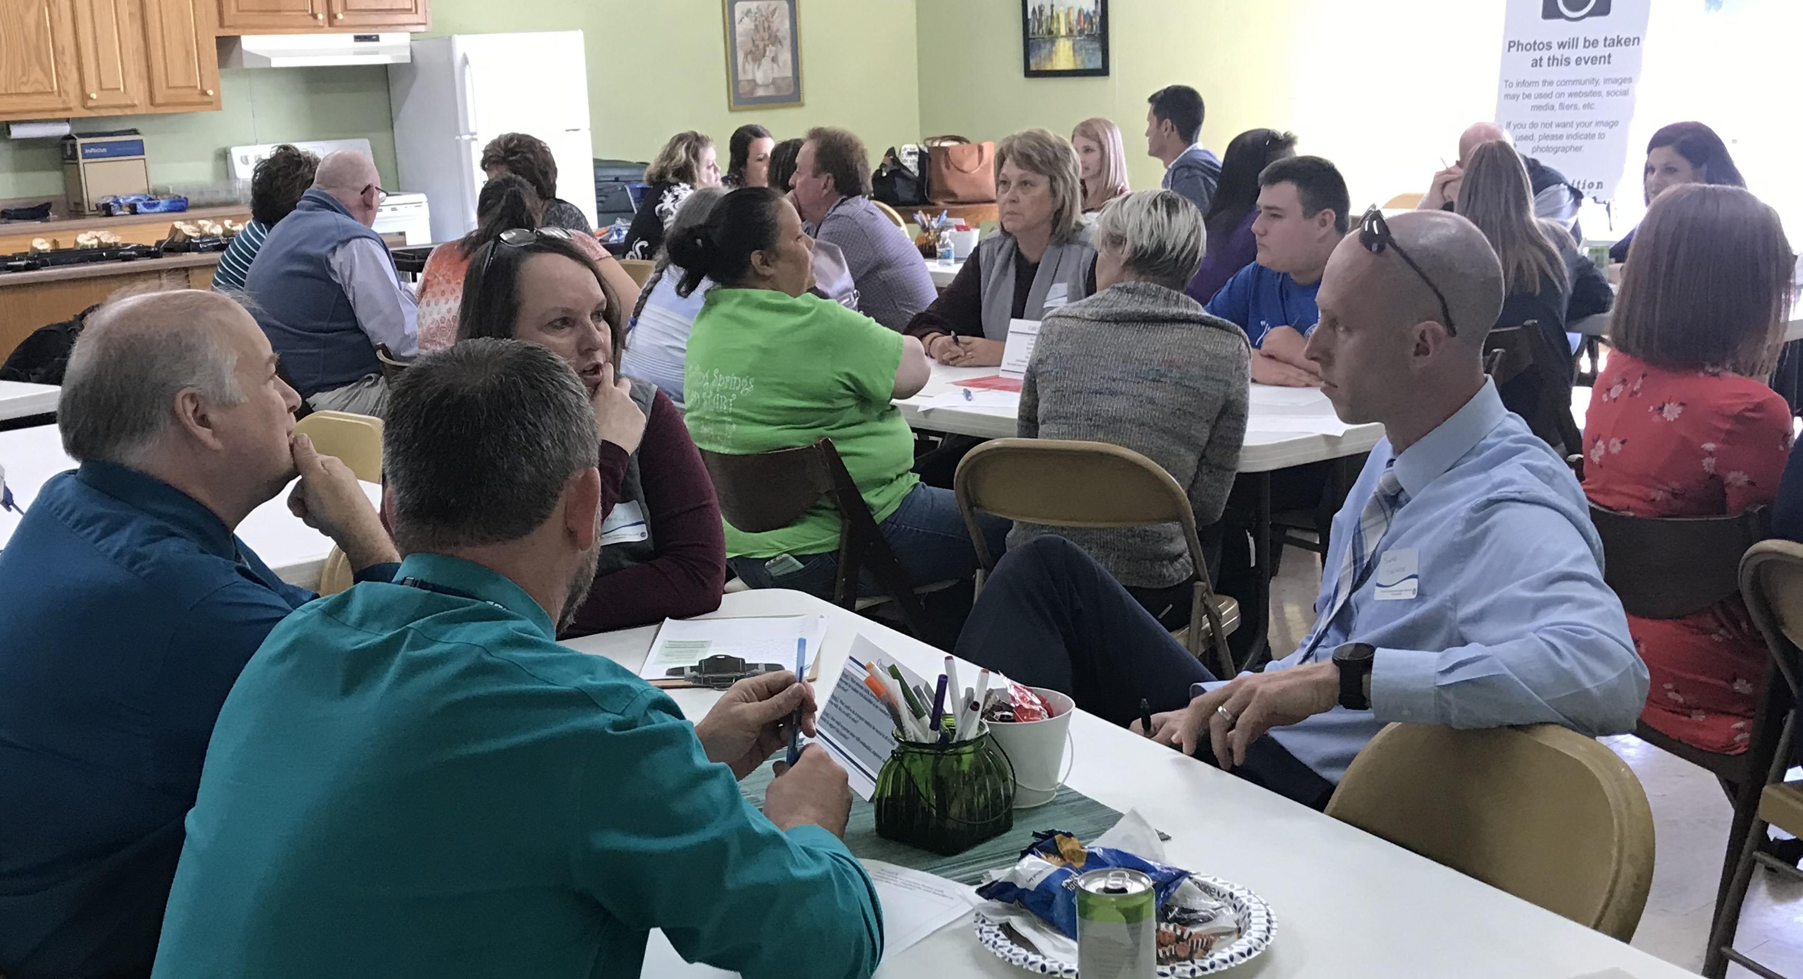
GOALS FOR TODAY
Learn something new
Share what you know
Meet people in our community
Enjoy yourself
Identify ideas that will help improve transition outcomes for our students!

Slide 4
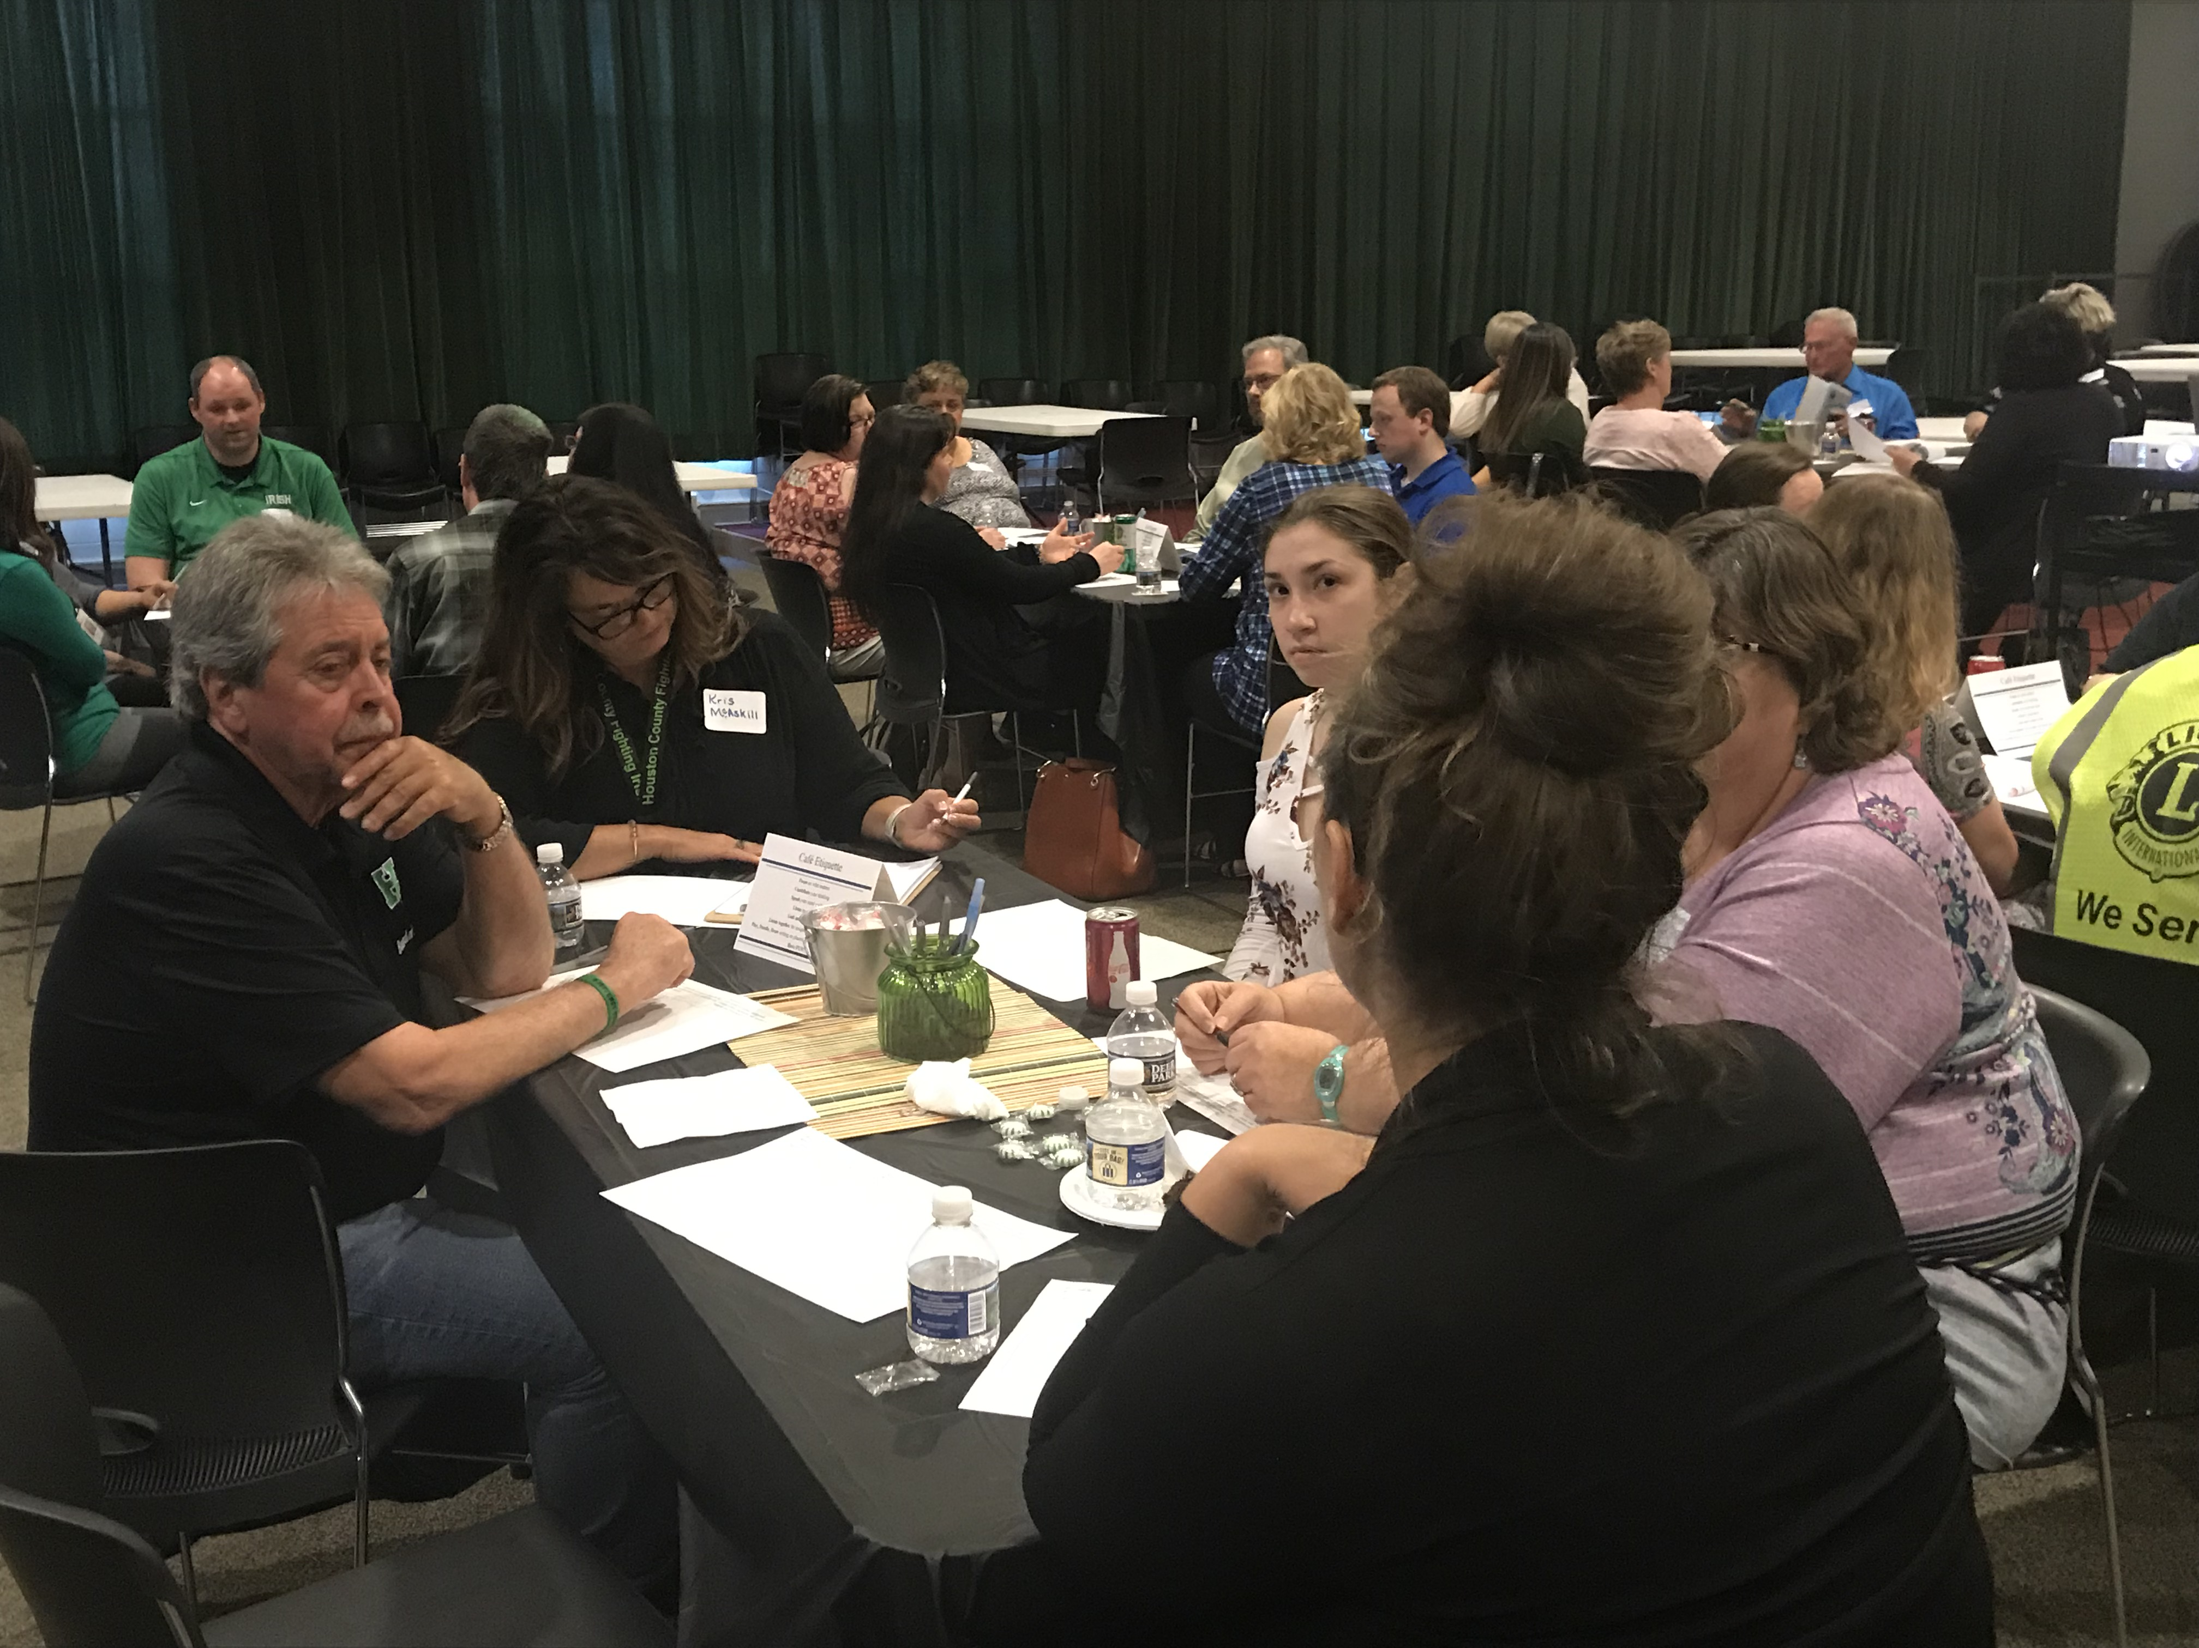
Event procedures
Overview Presentation
Round 1 Question (15 min)
Change Tables
Round 2 Question (15 min)
Change Tables
Round 3 Question
Group Share of Favorite Ideas Heard
Closing Remarks and Networking Time

Slide 5
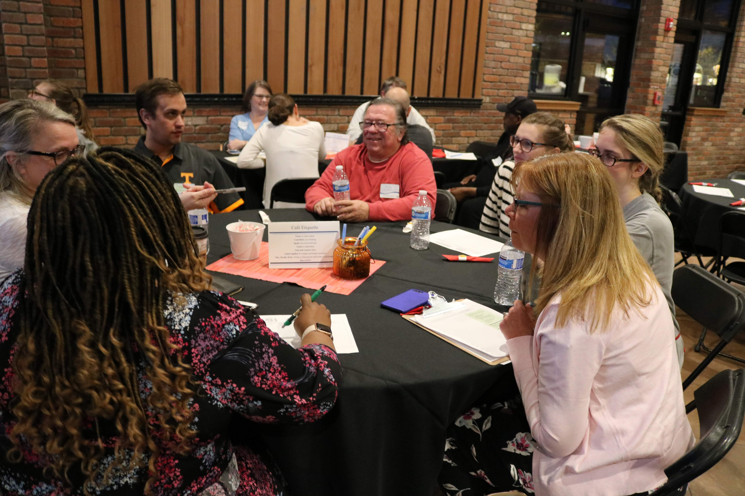
Table host roles
Start off with very brief introductions
Focus on ideas and possibilities (not problems)
Encourage everyone to share (or write ideas)
Write down all ideas (to give you back a guide)
Stay at the table when everyone else rotates

Slide 6
Table ETIQUETTE
Speak your mind—your ideas matter!
Doodle or write ideas on the placemats
Different perspectives are encouraged
Set aside “Yeah, buts...”
Build on ideas or offer alternatives, but don’t criticize or debate them
Replace barriers with solutions
Think outside the box
Explain your “jargon”
Keep any stories and examples brief
Do your “networking” right afterwards
Have fun!!!

Slide 7
What skills, experiences, and knowledge is necessary for students to find a good job in our community?
1
Round 1
15 minutes

Slide 8
Change tables

Slide 9
What could we do to better prepare students for employment while they are still in school?
2
Round 2
15 minutes

Slide 10
Change tables

Slide 11
How could we partner better with communities, employers, and families to support this transition to the workplace?
3
Round 3
15 minutes

Slide 12
Stay where you are

Slide 13
What are the most promising or exciting ideas you heard today?
4
Round 4
Whole Group Sharing

Slide 14
What to expect next

Slide 15
Complete the anonymous survey!

